Slide 1
 | Seminars in bioinformatics
 | Find the molecule function for cancer disease using Bioportal and find the relation between ontologies TASK :3 12/15/2022 Assuit university-Bioinformatics dep. Rana Hamed Group:2 Section :2

Slide 2
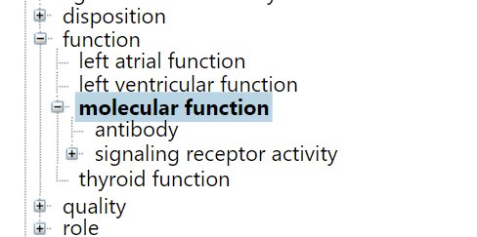
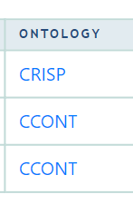

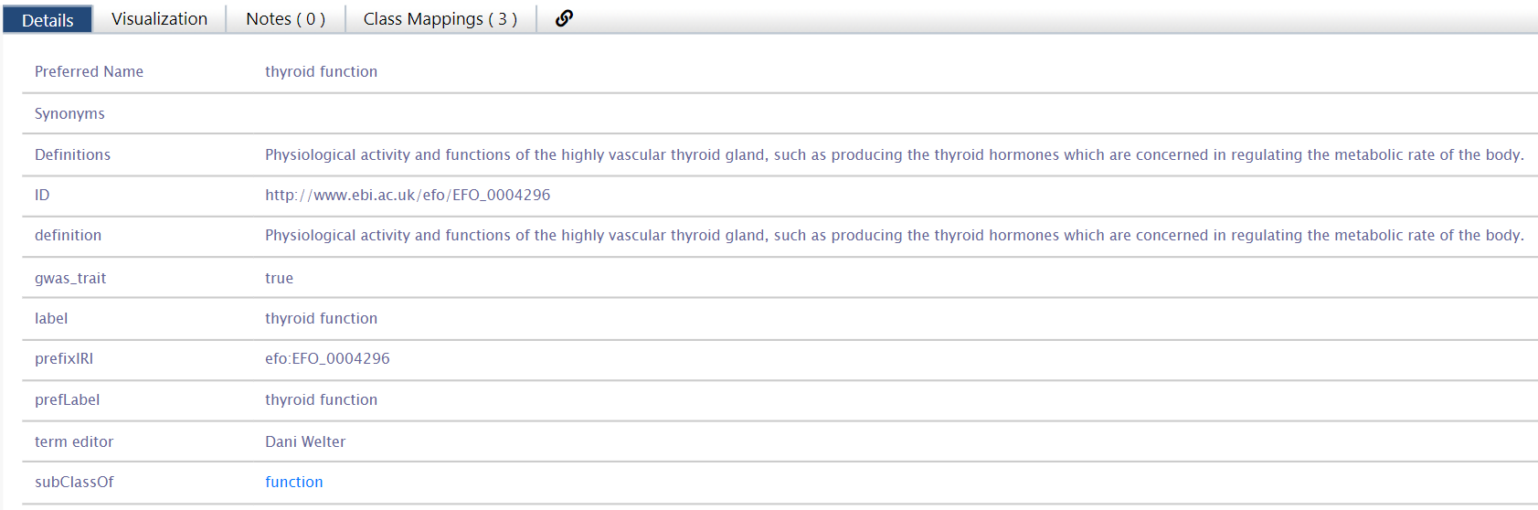
Thyroid Cancer Ontology
Search class for : molecular function
1-first method
Notes:
https://bioportal.bioontology.org/ontologies/EFO/?p=classes&conceptid=http%3A%2F%2Fwww.ebi.ac.uk%2Fefo%2FEFO_0004296#mappings

Slide 3

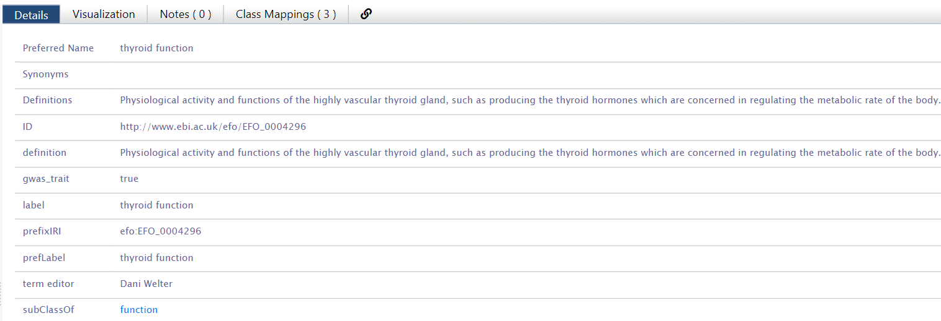
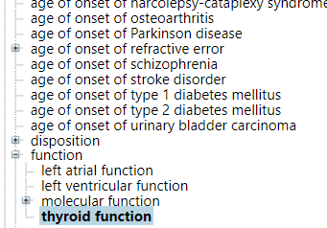
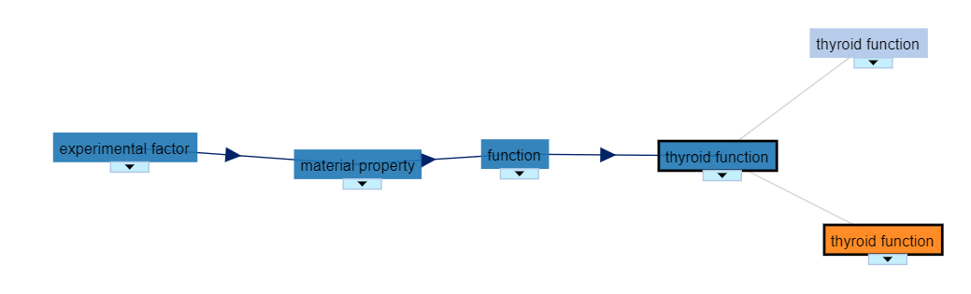

Slide 4
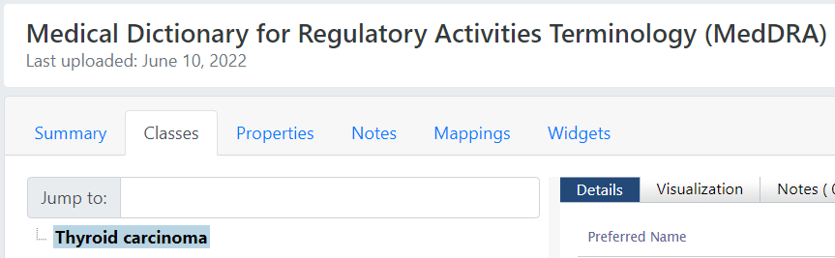

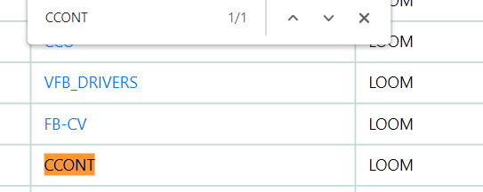
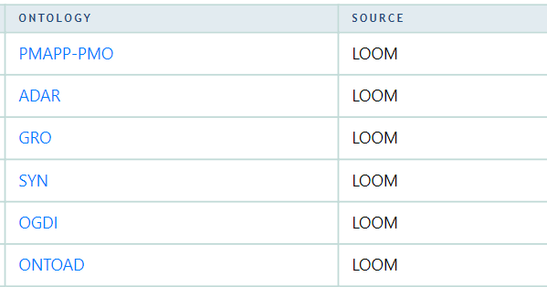
2- second method
Common molecular function ontology
Some of Unrelated molecular function ontology For this database:
LOOM source :takes two ontologies represented in OWL and produces pairs of related concepts from the ontologies. In order to identify the corresponding concepts, LOOM compares the preferred names and synonyms of the concepts in both ontologies. It identifies two concepts from different ontologies as similar
Notes:
https://bioportal.bioontology.org/ontologies/MEDDRA?p=classes&conceptid=http%3A%2F%2Fpurl.bioontology.org%2Fontology%2FMEDDRA%2F10043702#visualization

Slide 5
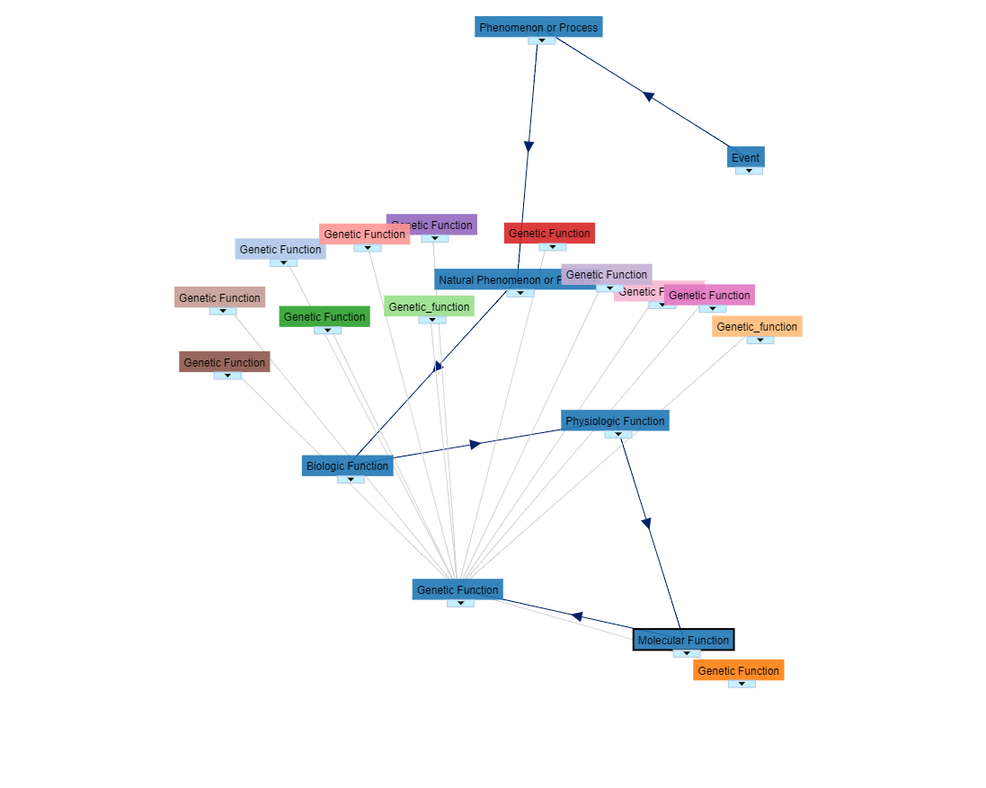
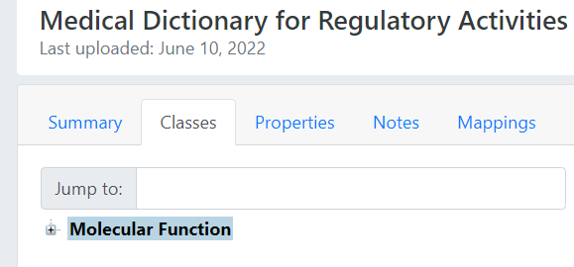

Slide 6


Related result from gene ontology cancer
Common molecular function ontology from :

Slide 7
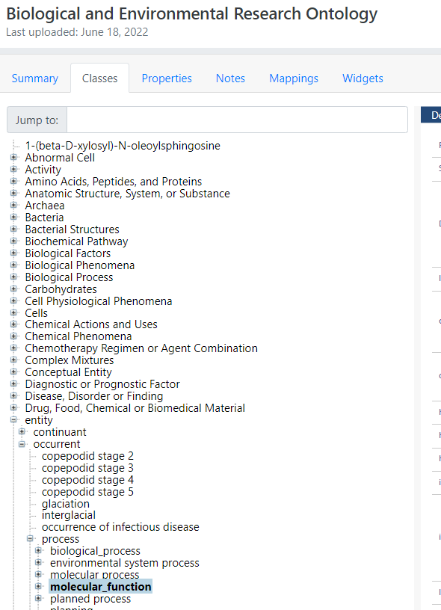
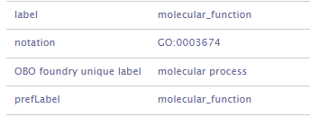

Slide 8

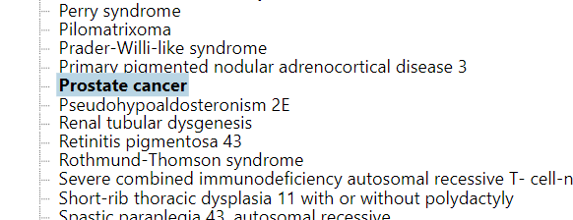
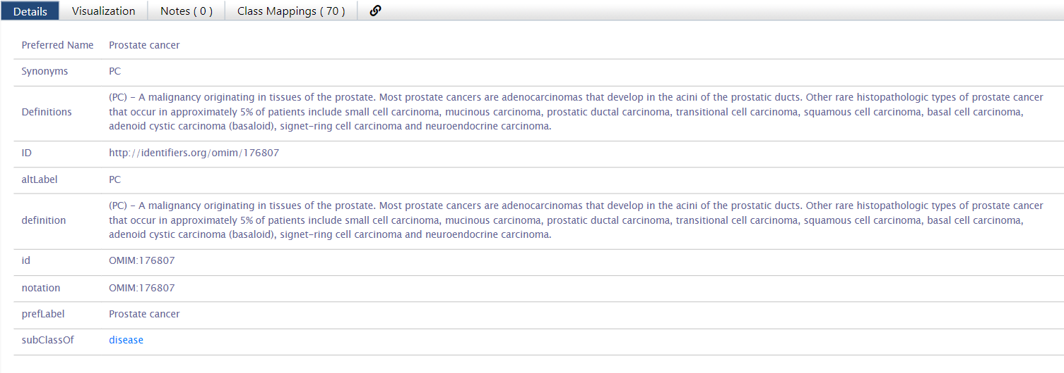

Slide 9

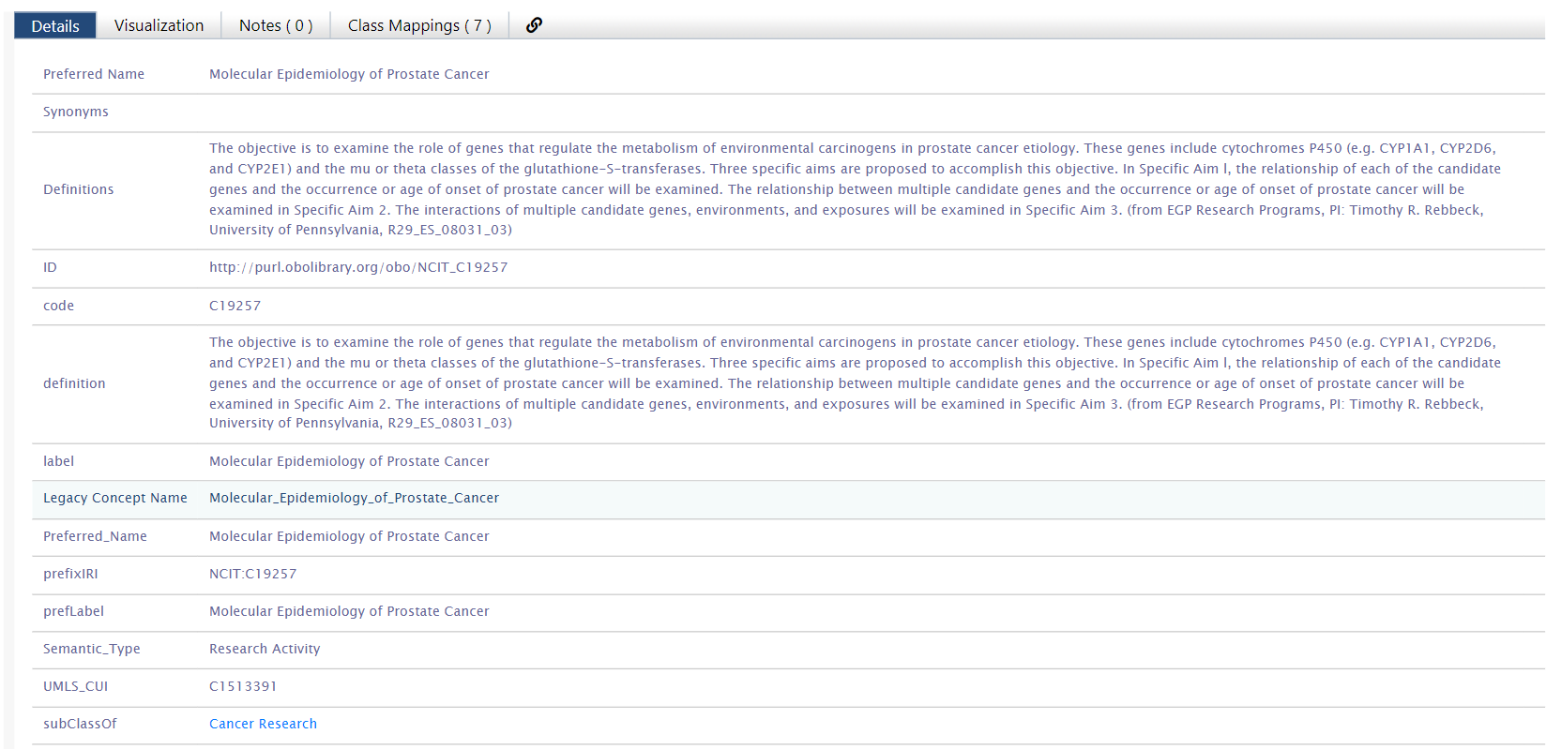
http://purl.obolibrary.org/obo/GO_0003674
PMAPP-PMO
ADAR
GRO
SYN
OGDI
ONTOAD
PIERO
PMAPP-PMO
COSTART
SNOMEDCT
RCD
OMIM
NCBITAXON
ICD10
STY
WHO-ART
ATC
ICD10PCS
CRISP
Notes:
https://bioportal.bioontology.org/ontologies/BERO/?p=classes&conceptid=http%3A%2F%2Fpurl.obolibrary.org%2Fobo%2FGO_0003674&jump_to_nav=true#mappings

Slide 10




Some of related and non-related molecular function ontologies in this database
Related to the Gene ontology of the cancer
From Gene Ontology of the cancer
PMAPP-PMO
ADAR →x
GRO
SYN
OGDI
ONTOAD
PIERO →x
PMAPP-PMO
COSTART
SNOMEDCT
RCD
OMIM
NCBITAXON
ICD10
STY
WHO-ART→ x
ATC
ICD10PCS
CRISP

Slide 11
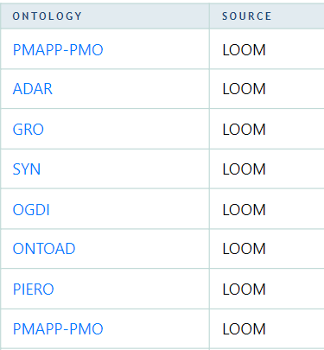
PMAPP-PMO
ADAR →x
GRO
SYN
OGDI
ONTOAD
PIERO →x
PMAPP-PMO

Slide 12

Related result from gene ontology cancer
PMAPP-PMO
ADAR →x
GRO
SYN
OGDI
ONTOAD
PIERO →x
PMAPP-PMO

Slide 13
Represent ontologies
Some ontologies represented between the two chosen types of cancer disease

Slide 14
Step1: open Bioportal website.
Step2: search using advances options for cancers/mutations ontologies disease data.
Step3: using Mappings tap
select Molecules interaction
select Molecular interaction ontology
choose Visualization to represent the ontology graph data.

Slide 15
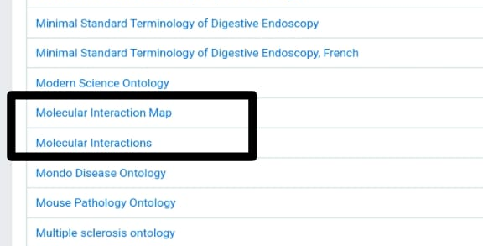
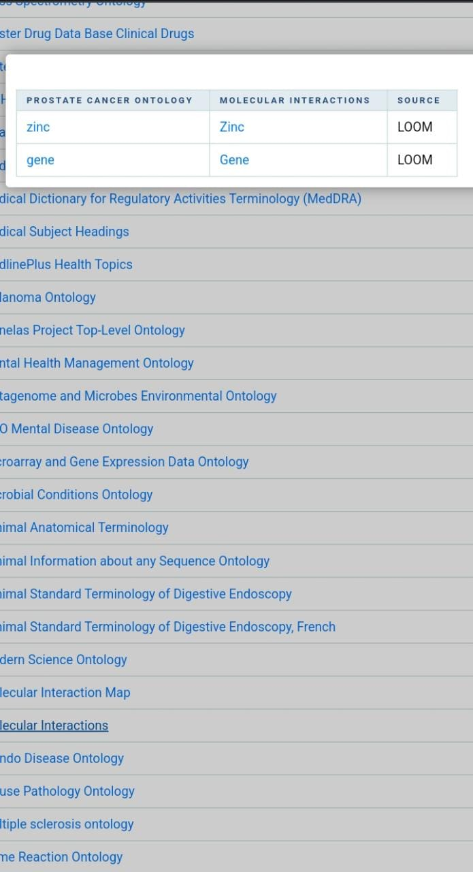
Prostate Cancer Ontology
Mappings tap to get ontologies
Ontologies for molecular interaction & prostate cancer
Zinc : in proteins can either participate directly in chemical catalysis or be important for maintaining protein structure and stability.

Slide 16
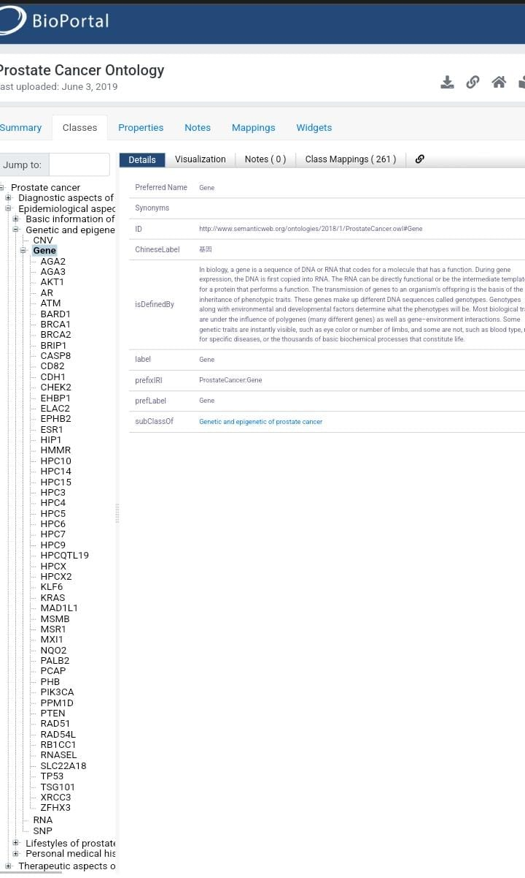
Molecular interaction ontology = Gene

Slide 17
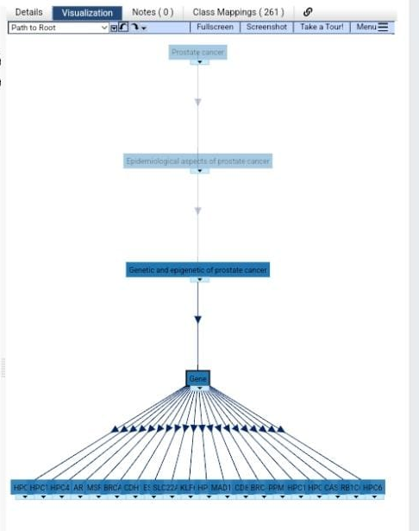
Graph visualization of all genes common between the cancer specifies

Slide 18
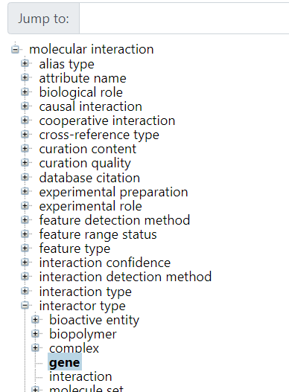
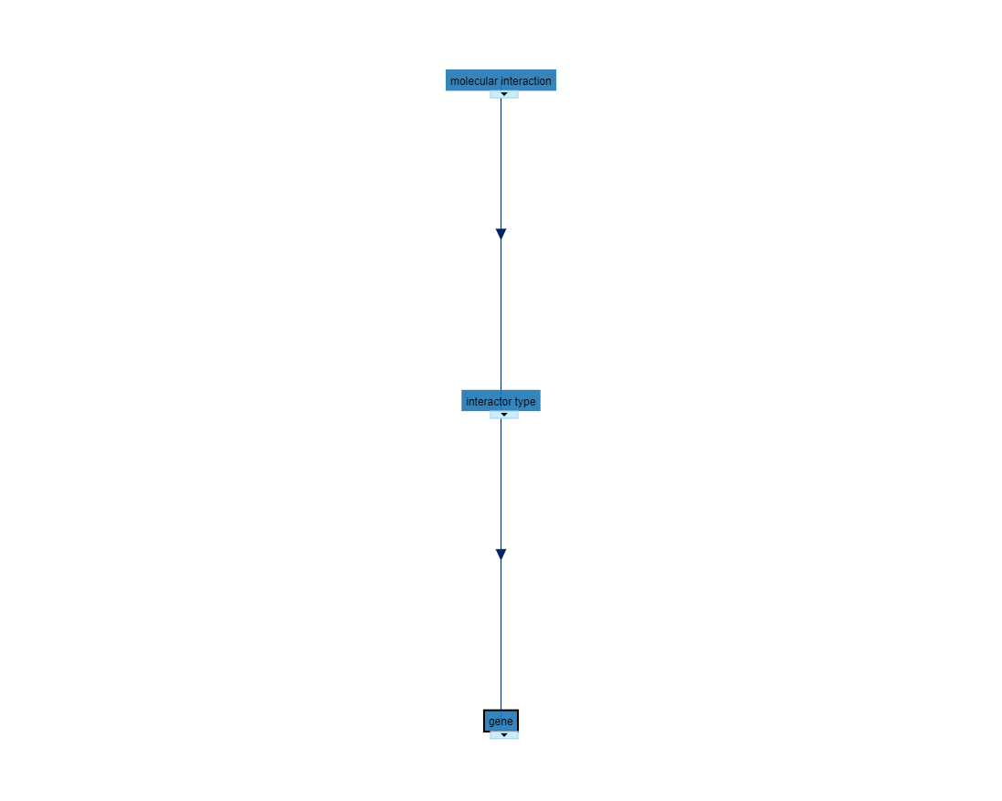
Prostate cancer molecular ontology = gene

Slide 19
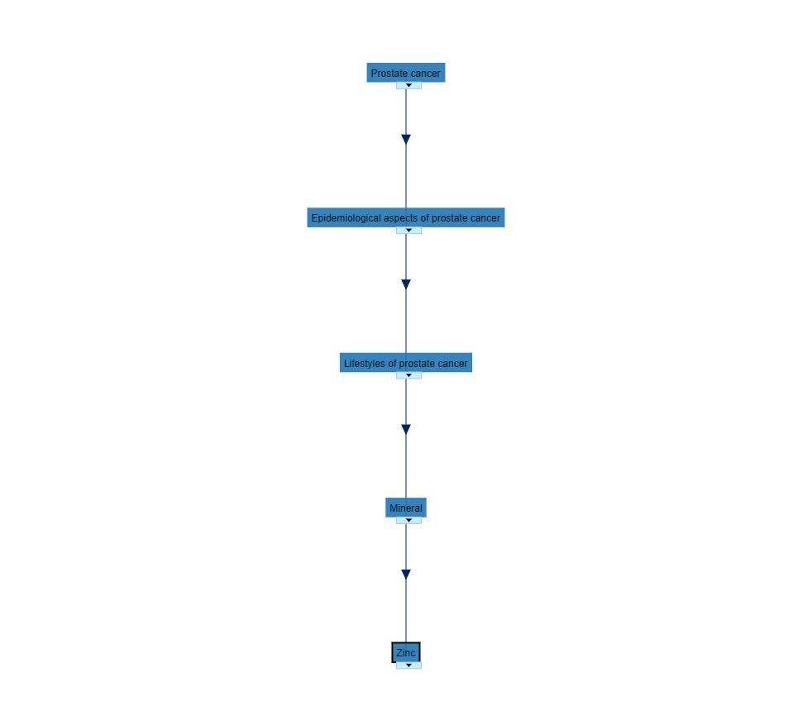
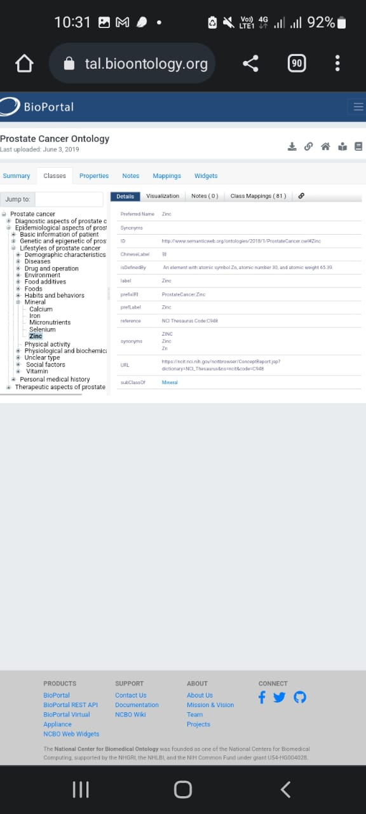

Slide 20
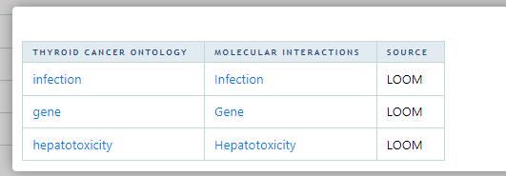
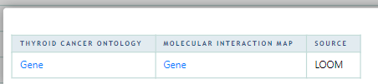
Thyroid Cancer Ontology
Mappings tap to get ontologies
Ontologies for molecular interaction & Thyroid cancer

Slide 21
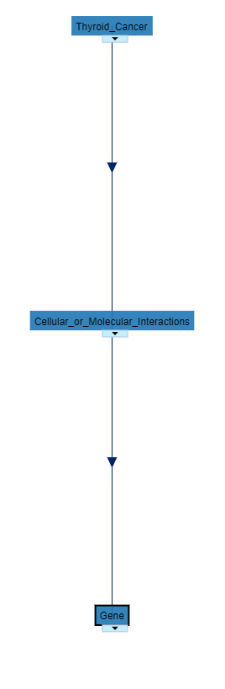
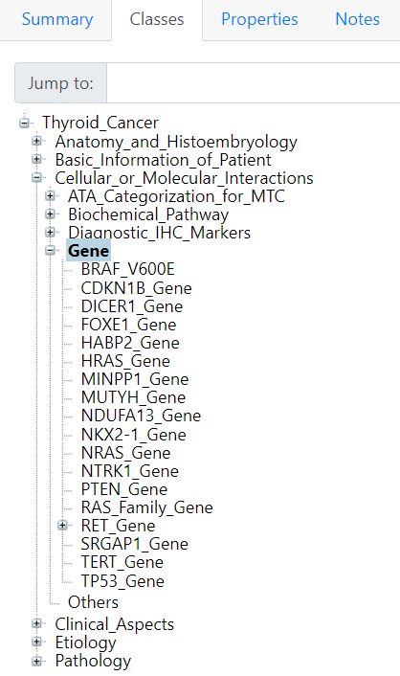
molecular interaction ontology

Slide 22
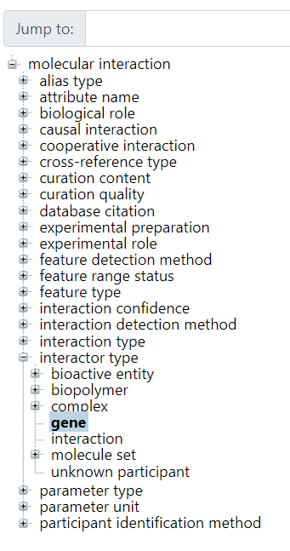
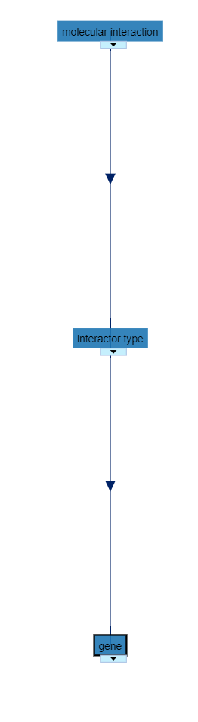
Thyroid cancer molecular ontology = gene

Slide 23
Gene ontology(go)

Slide 24
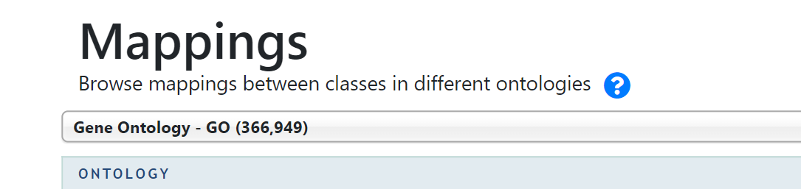
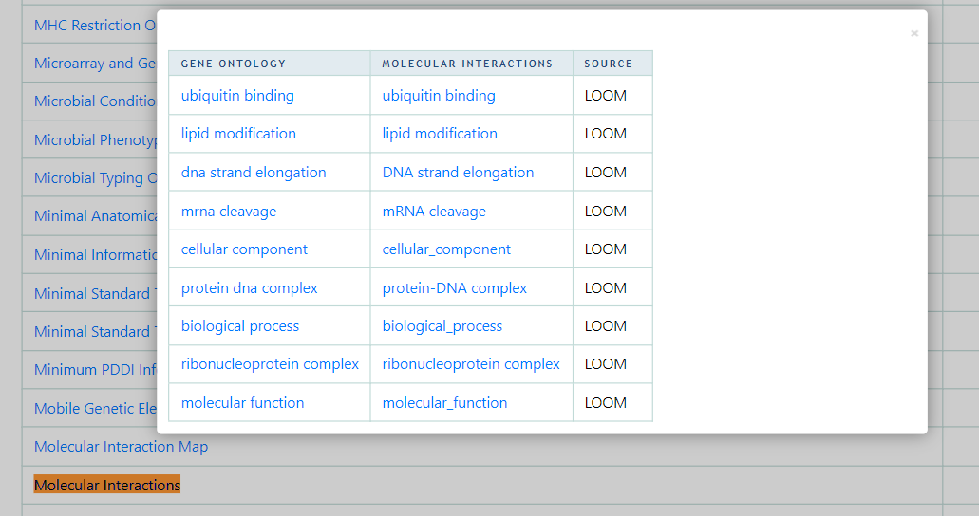

Slide 25
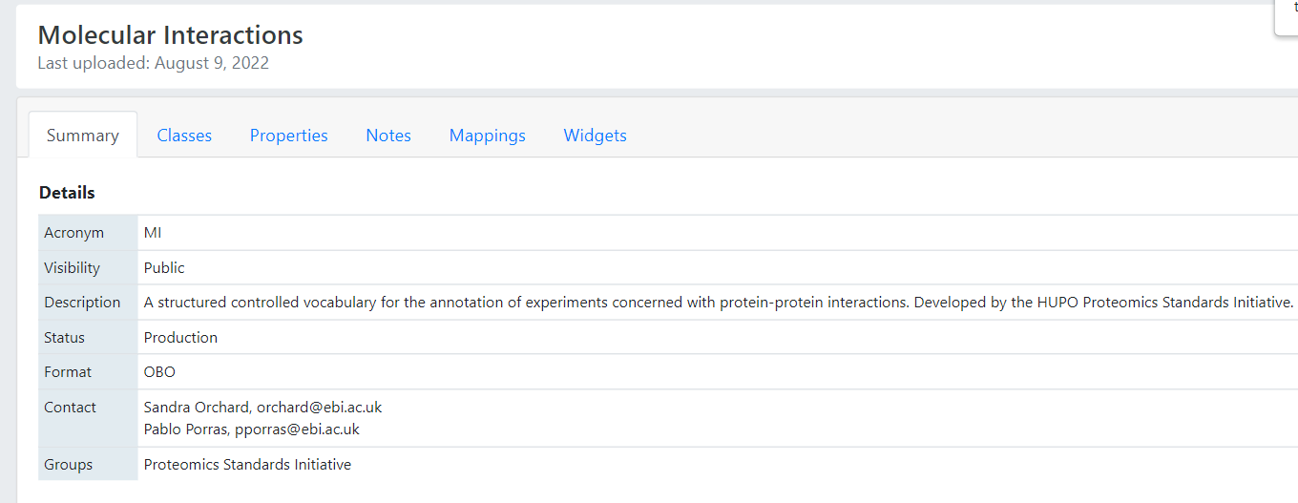

Slide 26
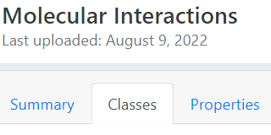
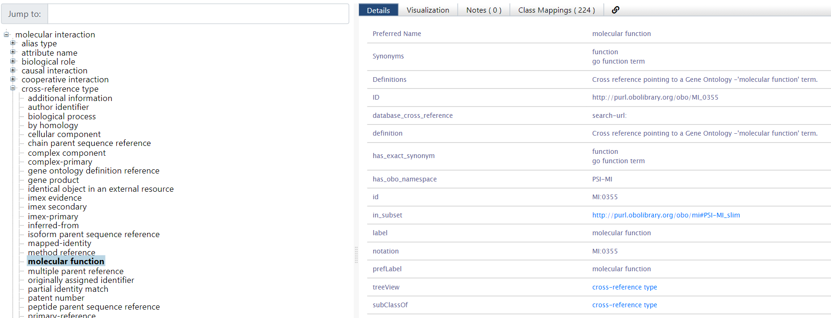

Slide 27
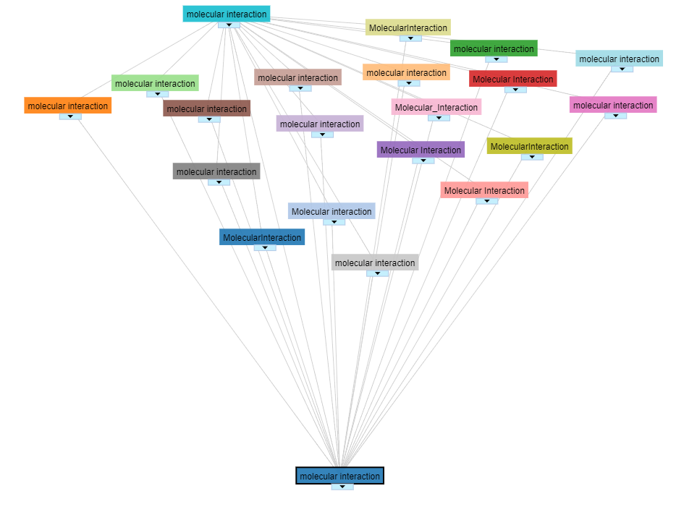
Each Ontology subclass of “molecular interaction” is found in different database as molecular interactions ontology
Where we can also find the molecular function of each cancer disease as shown

Slide 28
A common molecular interaction ontologies between both different types of cancers .

Slide 29
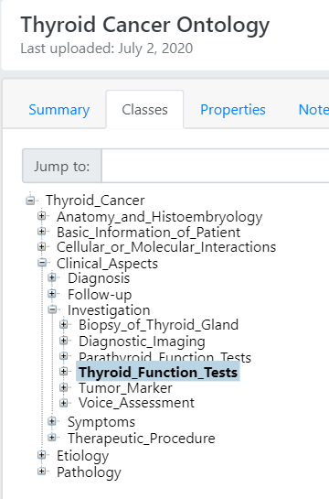
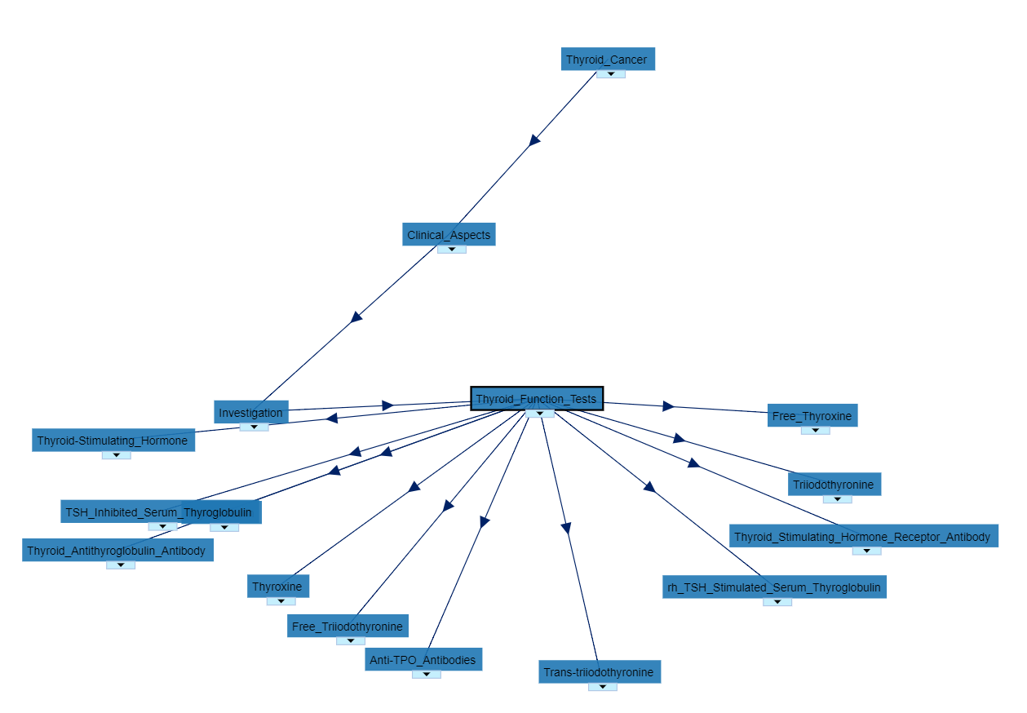

Slide 30
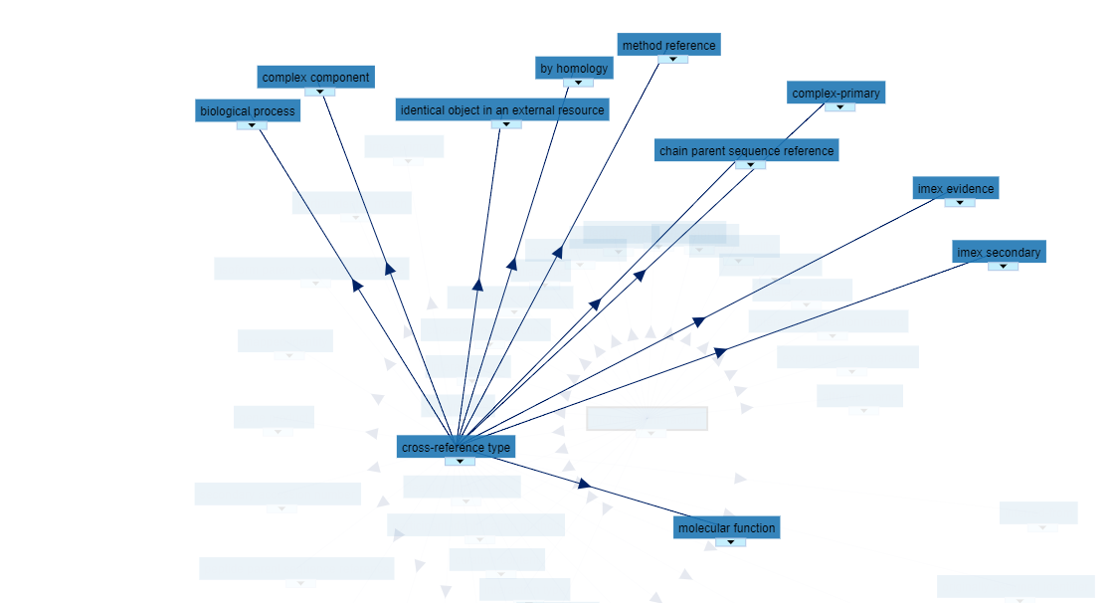

Slide 31
Using ANNOTATOR:

Slide 32
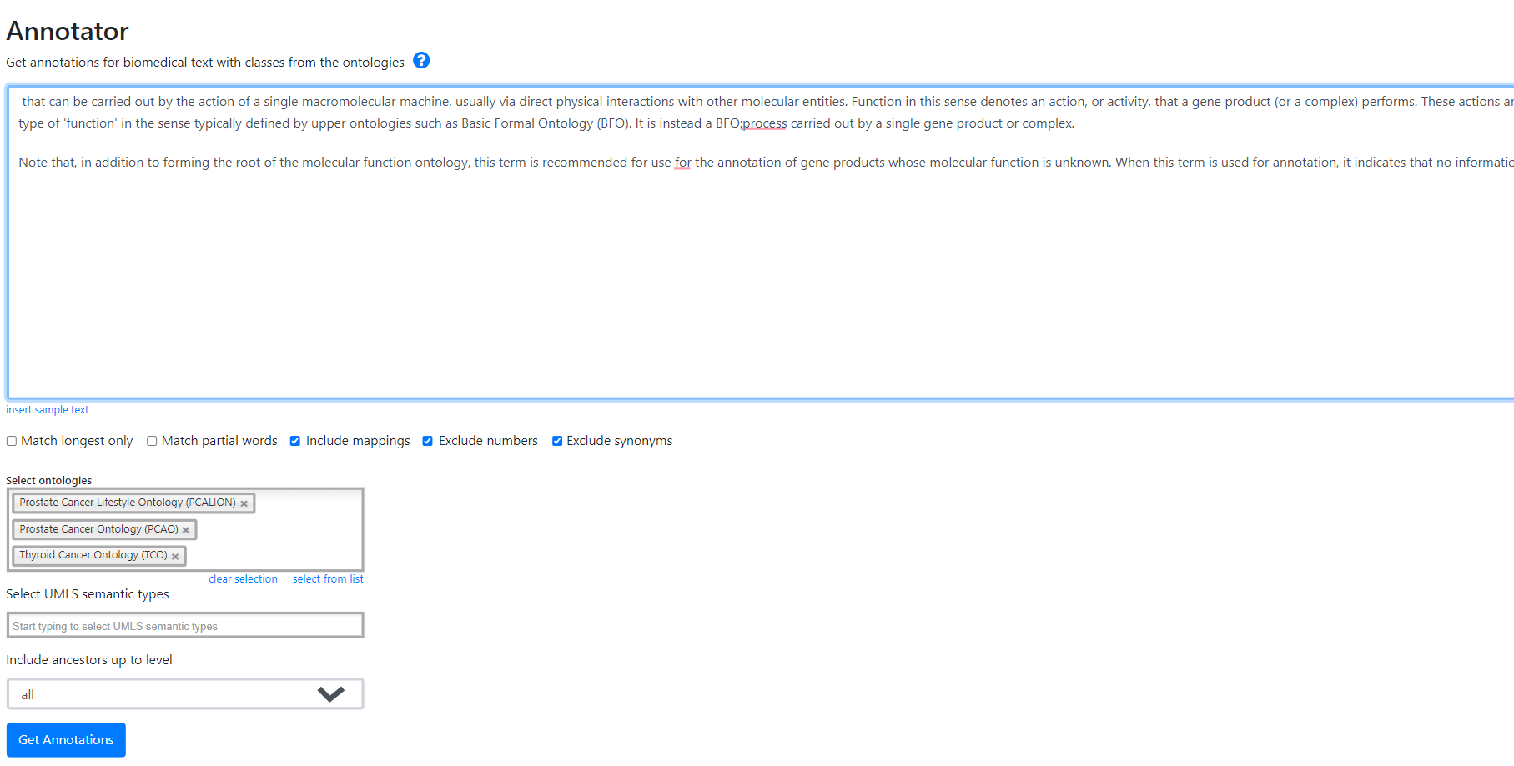

Select the definitions and all the ontologies for the molecular function to annotate the cancer diseases and see matched ontologies
The result:

Slide 33
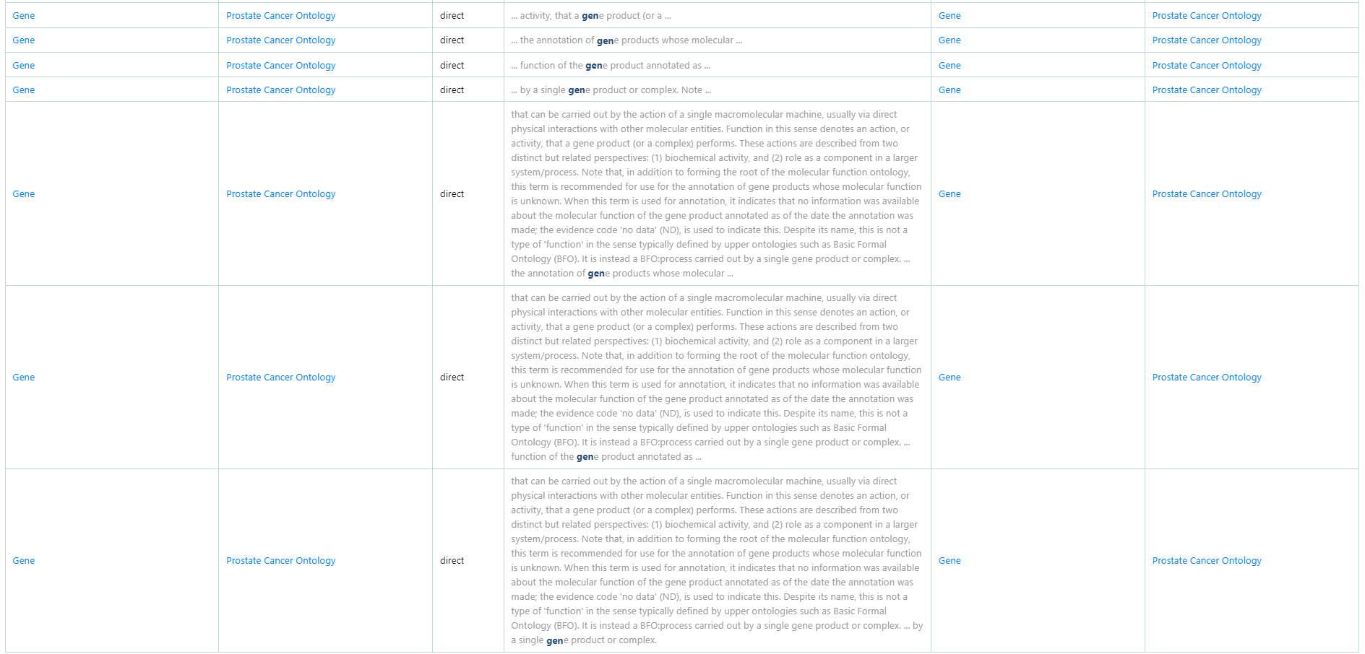

Slide 34
Using new Bioportal annotator version to find score :

Slide 35
Here an ontology gives overlapping annotations for the same input data.
EX: Cancer Gene and cancer_gene
so the low input gene ontologies are ranked among the top positions because they had multiple classes matching a few input terms
And this is represented in final score in Our new approach addresses this issue.
If an ontology provides several annotations for the same text fragment, only the annotation with the highest score is selected to contribute to the coverage score.

Slide 36
